Slide 1
Improving Cloud Gaming Experience through Mobile Edge Computing
By: John Ziegler

Slide 2
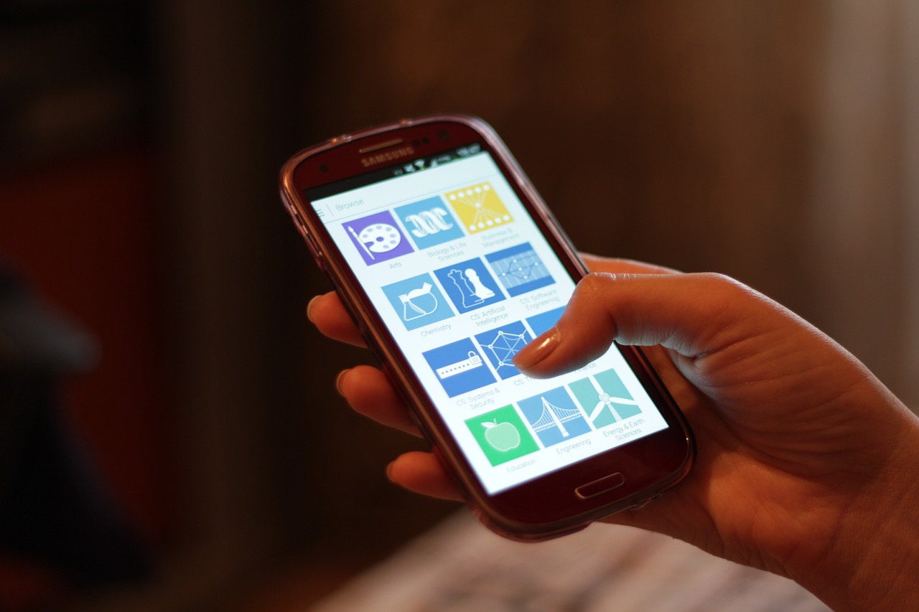


Introduction
If we can do so many things using the cloud from our smartphones already such as streaming music, and tv shows on demands, why not high-quality games?

Slide 3
Problem Definition
Why can’t we stream high-quality games using the cloud?
Low Delay Requirements - Latency, which is the delay before a transfer of data begins following an instruction for its transfer, can make games troublesome for the user. When latency is higher than 50ms, players will usually leave the game as it's too slow to play.
High Bandwidth Consumption - Recommended bandwidth to sustain an affordable-quality gaming experience is 3 Mb/s per user, but this limitation is also bounded by a minimum bandwidth of the path from cloud server to mobile user.

Slide 4
Importance of Cloud Gaming
Cloud gaming would make us be able to play any video game, anywhere, at anytime as long as their clients have the basic capacities for network connection, audio/video decoding and image display.
This could be the next step forward that we need to see in technology innovation. The ability to have unlimited computing power, storage, AND ideal bandwidth conditions with a low latency opens us up to a world of possibilities, especially with AI.
Could bring forth the next innovation in technology with the idea of using personal/private GPU/CPU’s when they are not being used, to be able to get us a closer path to the end user using the cloud, which might end up benefiting the user.

Slide 5
2 problems with past Cloud Gaming
Gaming via cloud consumes a great amount of computation, and communication resources simultaneously. ( input, state changes, etc..) This is because we need to update the game to the users inputs, and render the game scene with those inputs all in real-time, which eats up computation.
Paired with the game scene being sent to the player as a video sequence for interaction with low delay requirements, which consumes large amounts of bandwidth going from the cloud server to the user.

Slide 6
What is EdgeGame and how can it help?
EdgeGame was designed to make efficient cloud gaming a reality. It helps lower the bandwidth of the game by using edge nodes. It will perform the computation-intensive GPU rendering at the edge node, and then stream the scenes as video sequence back to the game client. The client is responsible for displaying the video, and collecting the players commands and sending them back to the edge node, which sends them back to the cloud data center incase the game should be resumed or replayed. The edge nodes involved form a “network” with each other allowing for quicker communication times between them and the user.

Slide 7
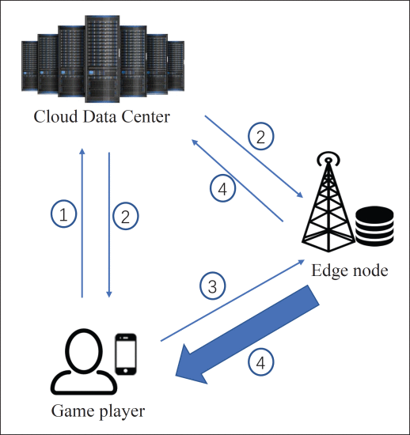
Framework of EdgeGame

Slide 8
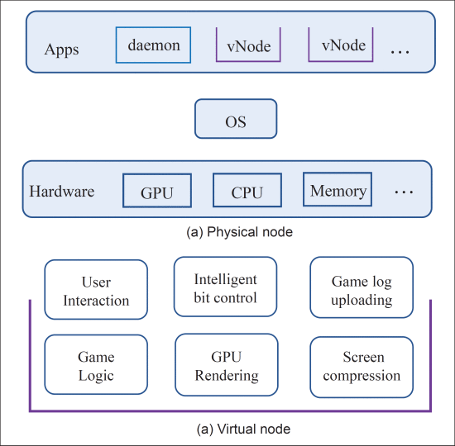
Structure of Edge Nodes
The edge node is the server that we are actually running the game on, but we don’t actually run it ON the edge node, we instead create a virtual node on the server that’s sole purpose is to get the input, process it in the game in real-time, and send it back to the user via updated video stream. Benefits of using the virtual node include lower startup time compared with running in a virtual machine, along with being able to separate the running games from the operating system in the physical node, which helps prevent corruptions of data, programs, and applications that are on the nodes edges. daemon works as a virtual node manager talking between data centers, and other nodes in the network.

Slide 9
How to get better bandwidth
Taking into account multiplayer games, we must be able to have synchronized actions between different servers to one game state. EdgeGame does this by having all edge nodes involved communicate with each other to improve overall quality of experience. The involved edge nodes create their own “network” with each other in order to get the video stream back to the user more quickly.

Slide 10
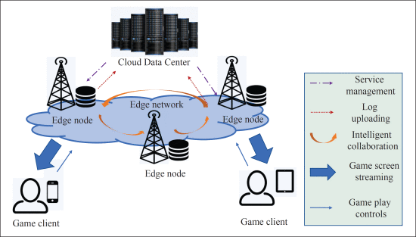
Edge Networks

Slide 11
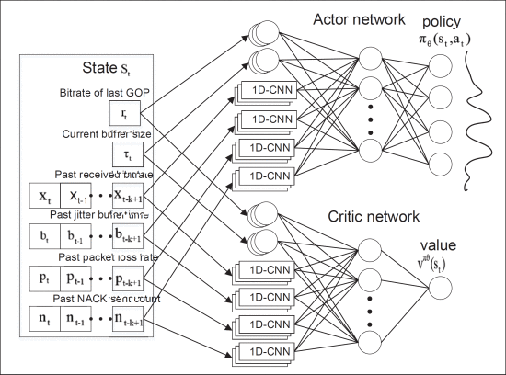
Benefitting from AI
EdgeGame takes advantage of AI to train its neural network to determine the optimized gaming experience by monitoring the bandwidth, and adaptively adjusting the bitrate speed of the Group of Pictures (GoP)

Slide 12
QoE Model
Quality of Experience (QoE) is any flaws during the game such as rebuffering, and smoothness. This is directly based on the GoP, which is a collection of successive pictures within a coded video stream. The QoE is based on the video bitrate of each GoP, smoothness between adjacent GoP’s, and rebuffering. We can determine the QoE at any point in time using the following
QoEt = log(Rt/Rmin) - μTt - v│log(Rt/Rt-1)│
Where:
R = Bitrate at point in time
log(Rt/Rt-1) = quality perceived by a user
T = stalling time
│log(Rt/Rt-1)│ is the penalty for video bitrate changes
U = freeze penalty factor
V = unsmooth penalty factor

Slide 13
Fault Tolerance
EdgeGame deals with fault tolerance in a similar way that most the cloud does. It accounts for failures at a node edge by keeping a backup of that data at the data center in case we need to get that state back because something went wrong. In addition to this, when sending the video stream back to the user, if one node edge is taking too long, it will search out another route that will be faster via communication between edge nodes and attempt that.

Slide 14
Summary
EdgeGame could be the start of the revolutionized cloud gaming industry using efficient algorithms to get a better/faster streaming service when it comes to gaming.
Uses edge nodes to perform computation, and video configuration, then sends it back to the user via video stream.
Edge nodes communicate with each other and create their own network
Load-Balancing AI helps resolve issues with bandwidth and latency.
Provides the idea of using personal/private computers when not being used, as a way to create edge nodes in more areas to secure a faster connection between them.

